Slide 1
The Tragic Hero
A Cross-Cultural Archetype

Slide 2
Standard Review
LAFS.910.2.6 – Analyze a particular point of view or cultural experience reflected in a work of literature from outside the United States, drawing on a wide reading of world literature.

Slide 3
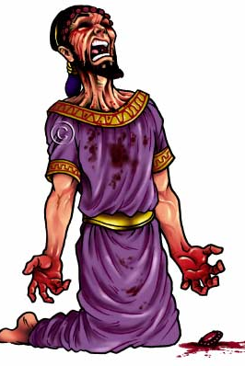
Lesson Essential Question:
What characteristics define the archetypal figure of the tragic hero?

Slide 4
Definition of a Tragic Hero
A person of:
noble stature (literally or figuratively)
outstanding quality or greatness
downfall caused by his/her own actions

Slide 5
Characteristics
Noble (literally or figuratively) birth
A tragic flaw (harmartia)
Increase in self-awareness during journey
Audience feels pity and fear for the character

Slide 6
Aristotle’s Tragic Hero
Aristotle defined a tragic hero as having the following characteristics:
Harmartia – a tragic flaw or error of judgment
A reversal of fortune brought about by the hero’s own error
Discovery that he is the cause of his own downfall
Excessive pride (hubris)
The character’s fate must be greater than deserved

Slide 7
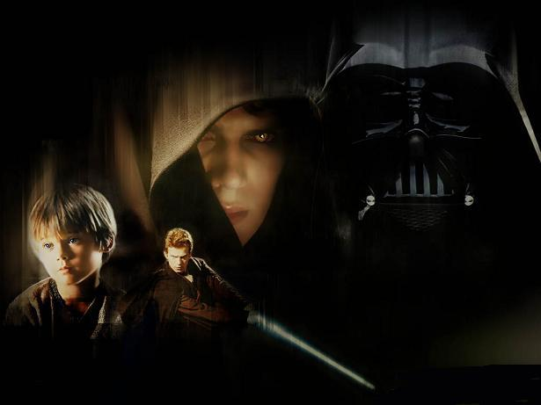
The Tragic Hero exists in literature throughout time and place

Slide 8
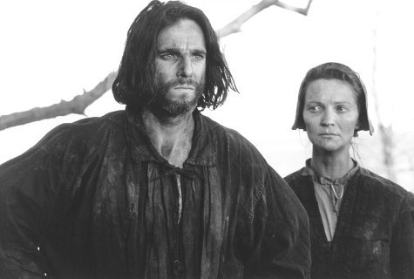

Slide 9
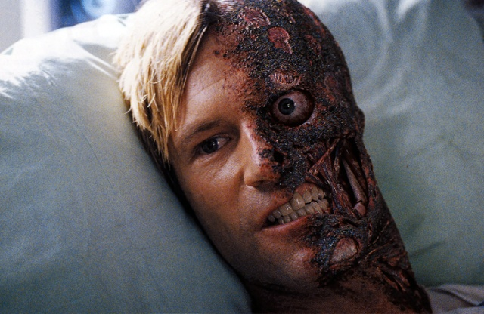

Slide 10
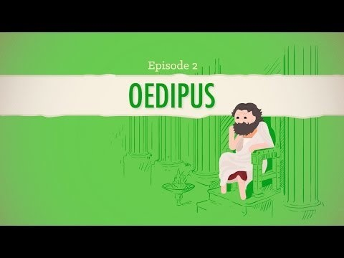
Sophocles’ Play Oedipus the King

Slide 11
What to Expect:
Julius Caesar was written with the goal of entertaining audiences in mind. As such, it is a suspenseful story that includes the following:
Meteors hurtling through the sky and lions pacing the streets of a city
A psychic spouting omens
Conspirators plotting to kill a leader
A hero “the noblest man that ever lived” – murdered before witnesses
Murders bathing their arms in their victim’s blood
People dying for the love of one another and county
One man’s ideals for a better country shattered forever

Slide 12
Imagine it is fifty years from now and you are being interviewed by someone authoring your biography. Use the Character Diagram handout to analyze your own character. Record significant details reflecting all six aspects of your character.

